Slide 1
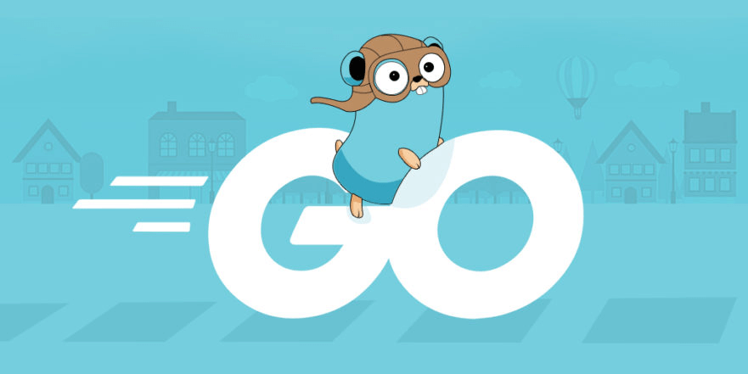
Golang get started
Hussain kazemi

Slide 2
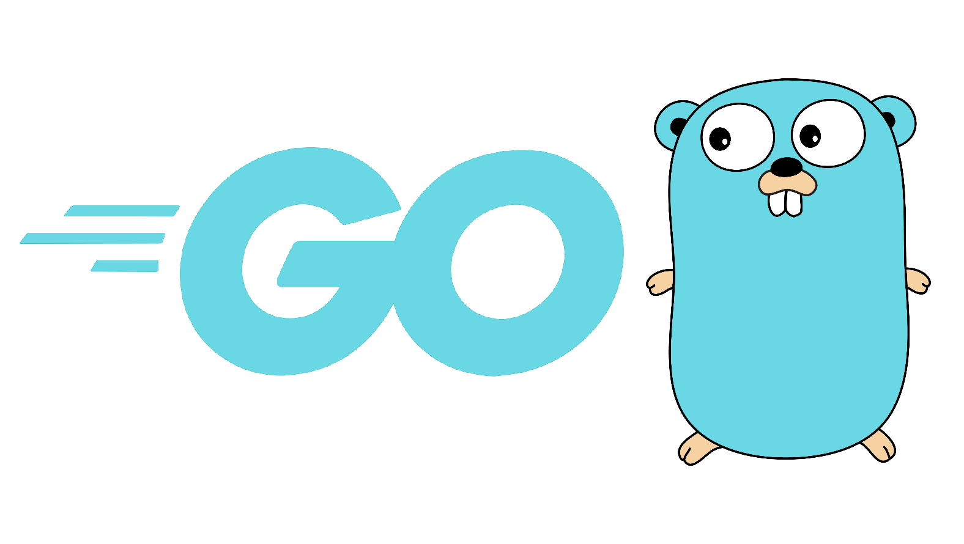
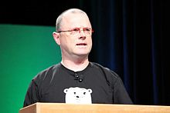
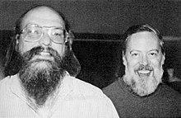
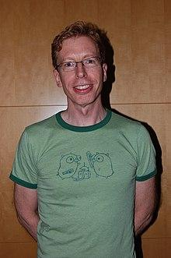
Golang introduction
Go was designed at Google in 2007, by Rob Pike, Ken Thompson, Robert Griesemer.

Slide 3
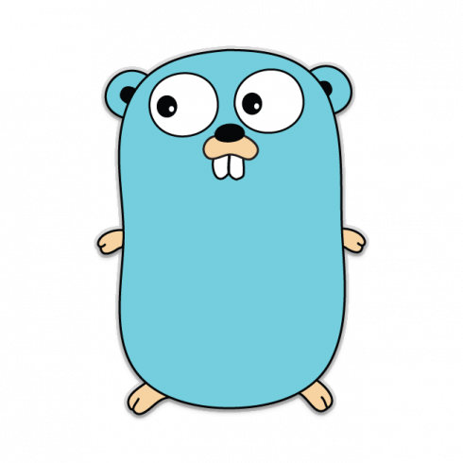

Golang introduction
Go was publicly announced in November 2009, and version 1.0 was released in March 2012.
In April 2018, the original logo was replaced with a stylized GO slanting right with trailing streamlines. However, the Gopher mascot remained the same

Slide 4
Why golang?
Open source
Static type
Concurrent
Compiled programming language
Syntactically similar to C, but with memory safety, garbage collection, structural typing
You can use for create web application,use in server-side, systemic programming,micro service...
Cross platform language
It’s a Web server.
Used in big company like google, youtube, facebook, cloudeFlare or big project like Docker.
Go format, no warning, comment needed, DRY(function, package, module)….

Slide 5
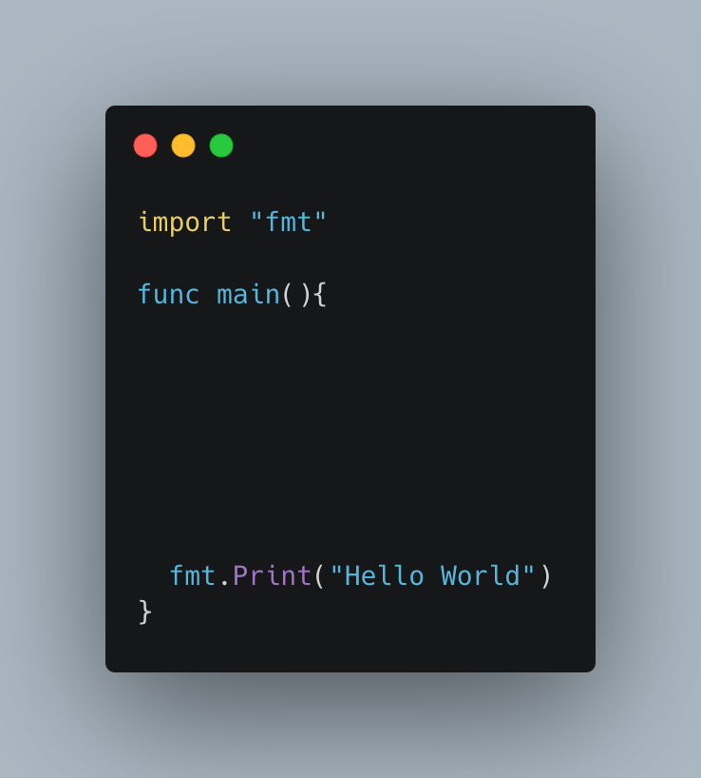
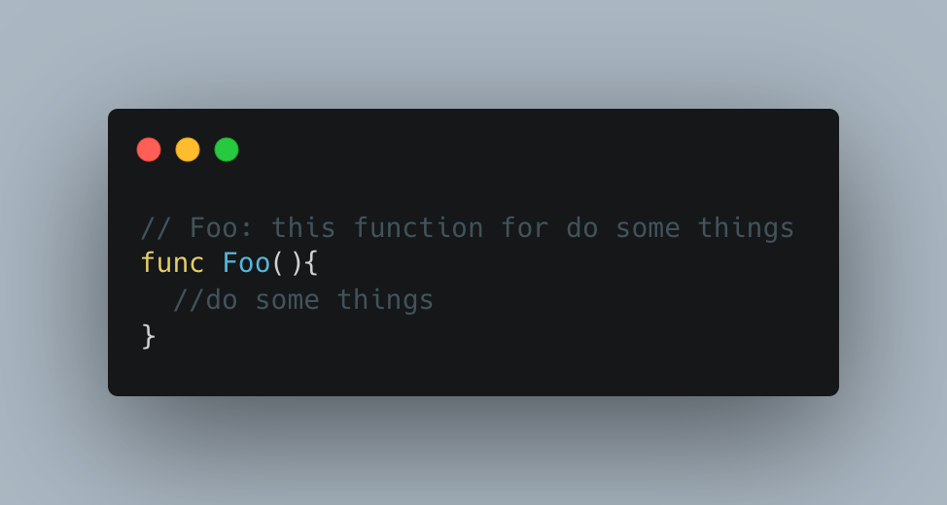
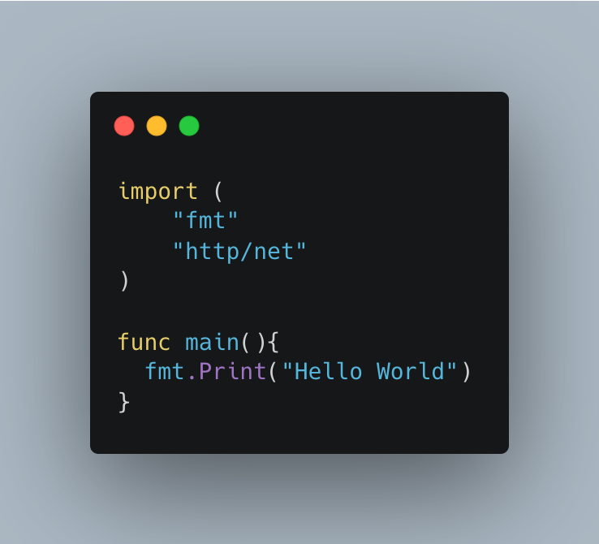
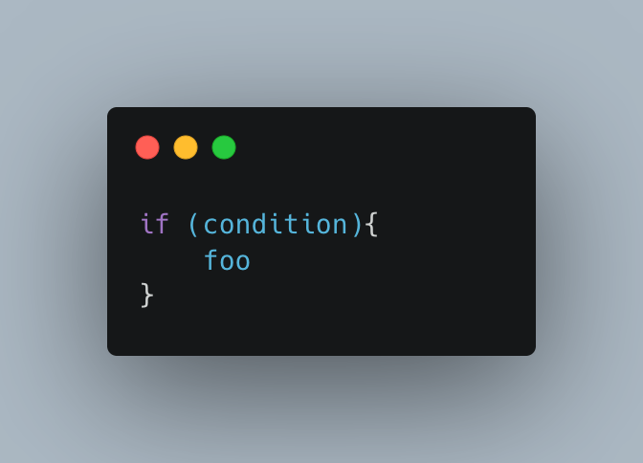
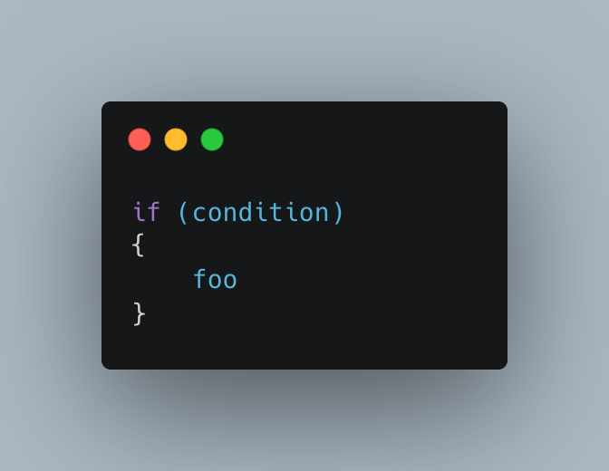
Some go format

Slide 6
Setup environment
Download and install go:
www.golang.org (vpn needed :( )
Your package manager
export PATH=$PATH:/usr/local/go/bin
IDE:
Vscode (no license needed, light, opensource)
Goland (professional)
Vim, emacs,....

Slide 7
List of the content (go version 1.16)
Hello world
Go tools
Data type, variables, constant
Condition
loop
Array, slice, map
Function
Error
panic, defer, recover
Type-struct
Method, interface
Concurrent
Go mod
Go test
Generic, context
Web application

